Slide 1

  IT TICKET ANALYSIS
Ashish Kumar
05/11/2025

Slide 2

DID YOU KNOW???
Nearly 70% of IT support tickets could be resolved with automated solutions, yet many companies still rely on manual processes.

Slide 3
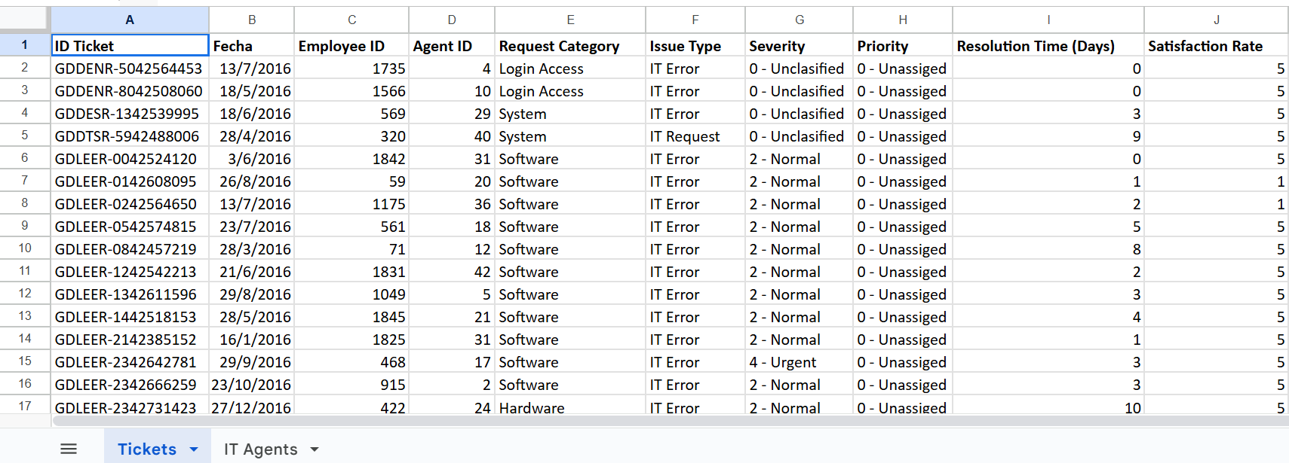
Problem Statement
The objective is to analyze the IT support ticket management system to understand the performance of IT agents, the efficiency of ticket resolution, and the satisfaction levels of employees. The analysis aims to identify high and low performers among IT agents, assess the overall effectiveness of the team, and pinpoint areas for improvement in the ticket resolution process. The ultimate goal is to make informed staffing decisions, including hiring, firing, and training, to enhance overall service quality and team performance.

Slide 4

ABOUT THE IT TICKET ANALYSIS
IT ticket analysis focuses on streamlining and optimizing IT services to the employees.
Key Objectives :
Ticket Categorization :
Analyze ticket types, priority levels and type of issue involved
Root Cause Analysis :
Identify recurring issues and propose long-term solutions
Performance Metrics :
Monitor resolution times, workload distribution and SLA compliance.

Slide 5

DATA OVERVIEW
Ticket ID : Unique identifier for each ticket
Date : Date of creation of the ticket
Agent ID : Unique identifier for agents
Employee ID : Unique identifier for employees who raised the ticket
Priority : Levels such as Low, Medium, High
Type : Such as Login Access or Login Request
Category : Hardware, Software, System etc
Resolution time : Time taken to resolve the issue
Satisfaction Rating : Ratings given by employees based on their satisfaction level

Slide 6

Data cleaning steps undertaken :
Changed the format of date column to YYYY-MMM-DD format in the tickets sheet.
Make a Year, Month, Day and Month-Year column from Fecha.
Fetch Agent Name from IT Agents to Ticket Sheet.
Make a SeverityNum column to get only numeric values from Severity.
Used the date function to obtain the DOB of agents in IT agents sheet.
Calculated the age of the employees in IT agents sheet
Extract domain name from Email in IT Agent Sheet
Found for duplicate entries, but no duplicates values found.
Only wrong values were there in Severity column which corrected by Find and Replace method.

Slide 7

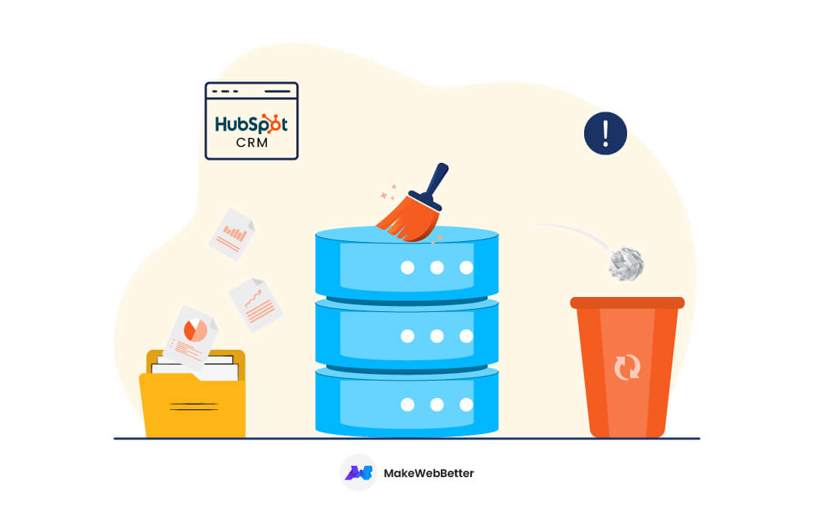
DATA ANALYTICAL APPROACH
Data cleaning : Used remove duplicates and find and replace to clean the data
Data enrichment : Used VLOOKUP to extract the agents name from the other sheet, using AVERAGE function calculated the average age of employees and also DATE function to format the date
Descriptive Analysis : Employed Pivot tables for summarizing key metrics and identifying patterns
Trend Analysis : Conducted time series analysis using various types chart to understand the performance of IT agents over time
Visualization : Created dynamic charts and dashboards for data representation, enabling interactive data exploration

Slide 8
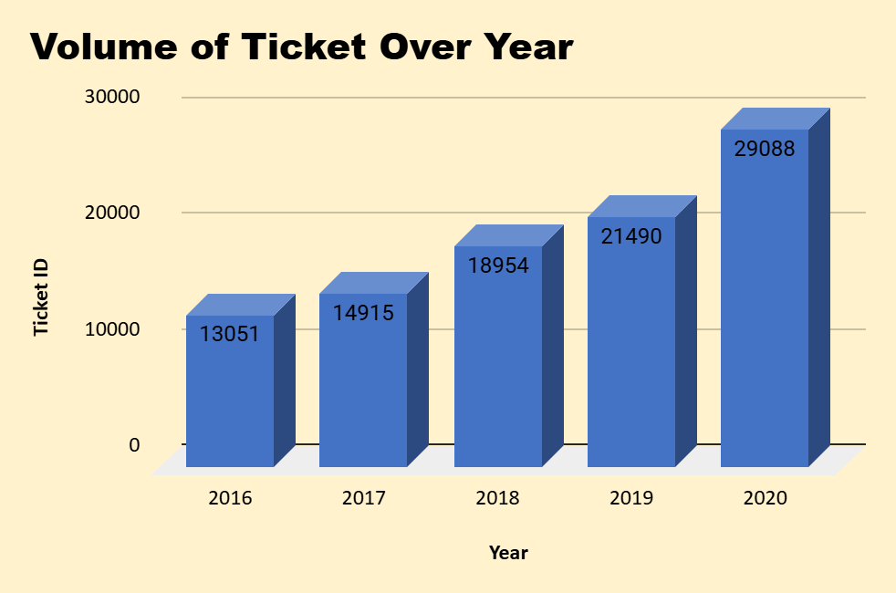
VOLUME OF TICKETS OVER YEAR
INSIGHTS :
Steady growth in ticket volume over the past 5 years
A significant jump in 2020, possibly due to external factors like remote work shifts during the pandemic.
The Chart is showing Year wise growth peaks at 29088 tickets in 2020, indicating a larger-than-usual spike.
Consider forecasting future volumes and planning resources accordingly

Slide 9
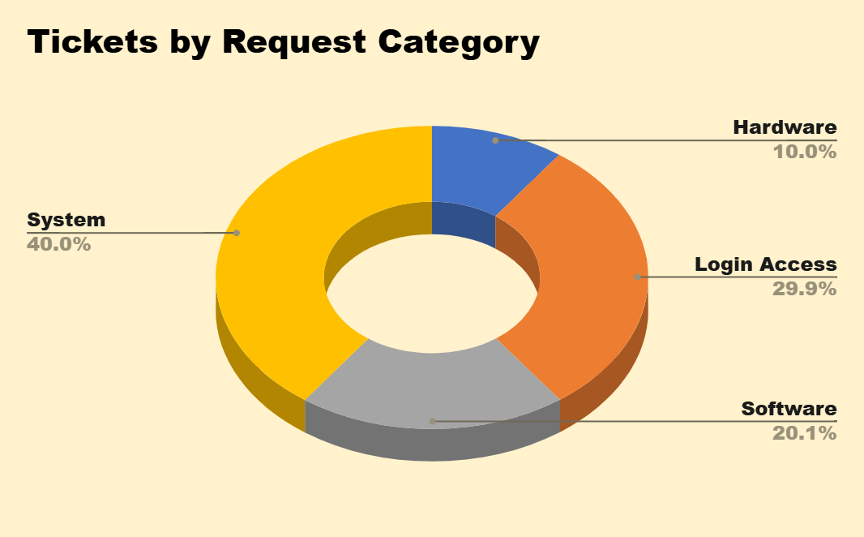
DISTRIBUTION OF TICKETS BY REQUEST CATEGORY
INSIGHTS :
System Issues represent the largest category and should be a focus for proactive monitoring and resource allocation.
Login Access issues make up a significant portion of tickets; implementing self-service tools can alleviate pressure.
Software Issues could be addressed with better user training and regular software updates
Hardware Issues remain a smaller category, but streamlining them will improve resolution efficiency.

Slide 10
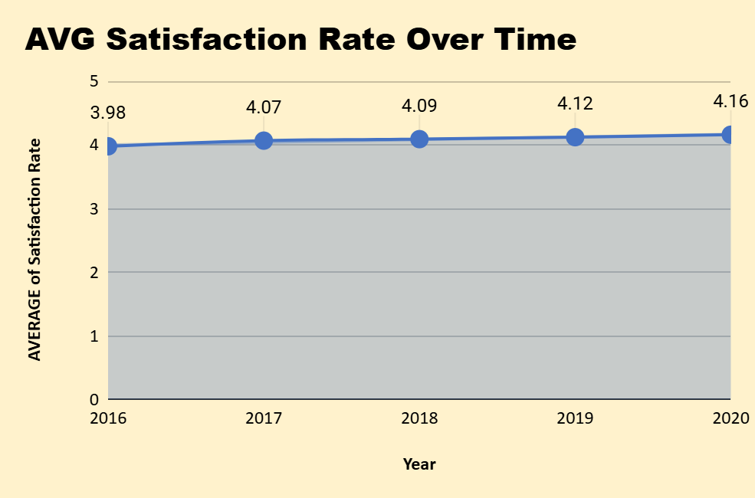
AVERAGE OF SATISFACTION RATE OVER TIME
INSIGHTS :
The steady increase in satisfaction from 2016 to 2020 indicates that IT support is improving and users are responding positively.
The consistency of the increase, particularly the slight rise in 2020, suggests that IT support team adapted well to increasing demand, potentially through better communication, improved tools, or more efficient handling of tickets.

Slide 11
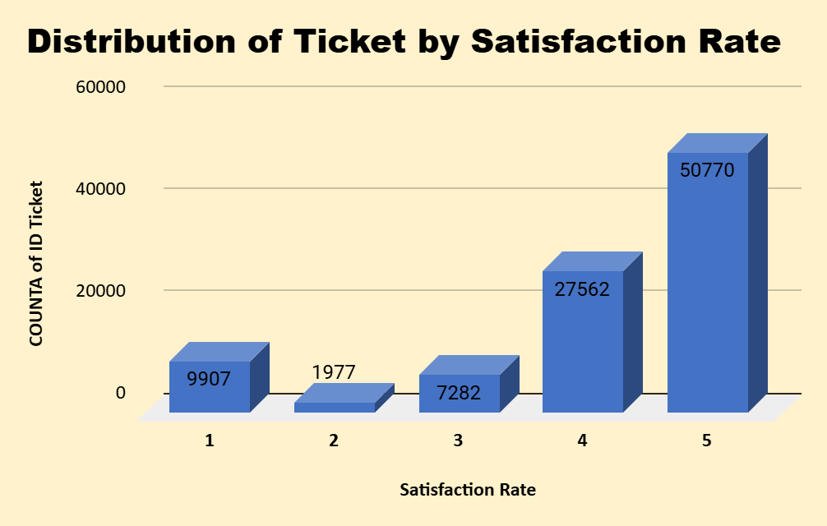
DISTRIBUTION OF TICKETS BY SATISFACTION RATE
INSIGHTS :
High Satisfaction: The majority of tickets are rated highly (4 and 5), indicating that IT support is generally meeting or exceeding expectations.
Low Satisfaction Focus: However, tickets rated with low satisfaction scores (1-3), indicating areas where support could be improved. This group represents an opportunity to analyze and improve the underlying causes of dissatisfaction or neutrality

Slide 12
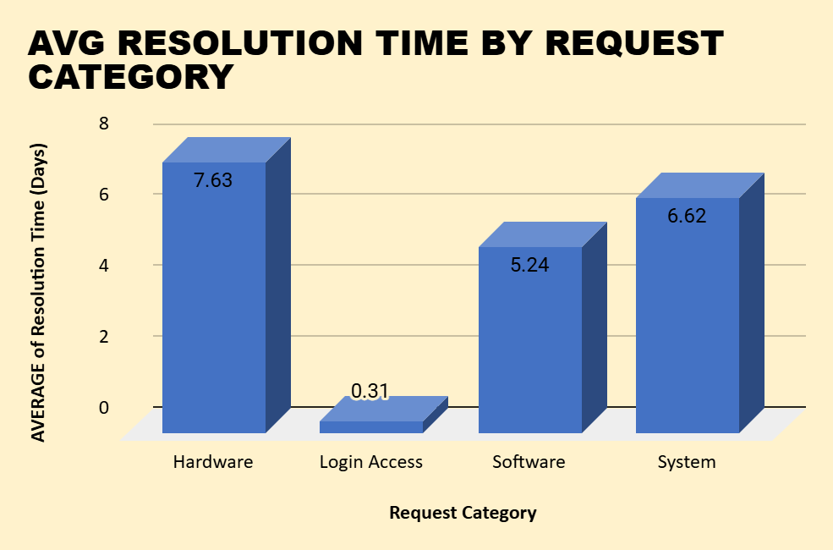
AVG RESOLUTION TIME BY REQUEST CATEGORY
INSIGHTS :
The login access category is already highly efficient with consistent and lower resolution times.
Hardware and system request resolution times remain stable but may benefit from further optimizations to reduce the average time for these more complex issues.
The software category shows slight fluctuations, with a need to focus on investigating Qtr 4's slight increase in resolution time.

Slide 13
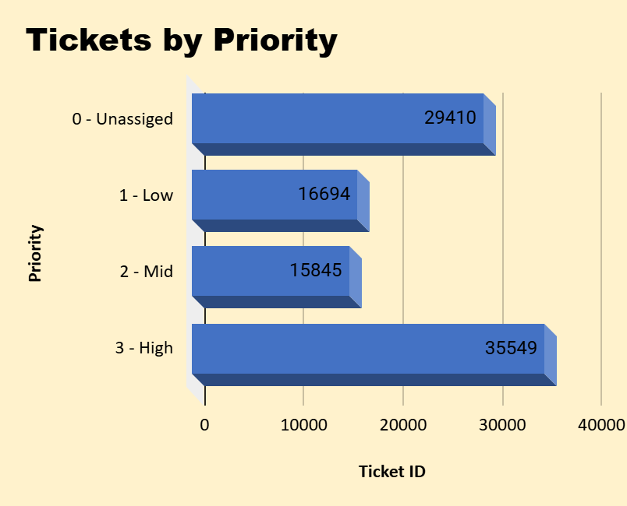
TICKETS BY PRIORITY
INSIGHTS :
The highest number of tickets falls under High priority. This indicates that a significant portion of the issues being reported is considered critical or urgent, which may require immediate attention or have a larger impact on users or business operations.
The large number of unassigned tickets is concerning. Unassigned tickets could indicate a backlog, inefficiency in ticket triage, or a lack of capacity to allocate issues to the right support teams.
The medium-priority tickets fall in between high and low, making up a fairly large portion of the ticket pool. These may represent issues that need attention but are not urgent, and resolving them in a timely manner is important to prevent them from escalating into high-priority tickets.

Slide 14
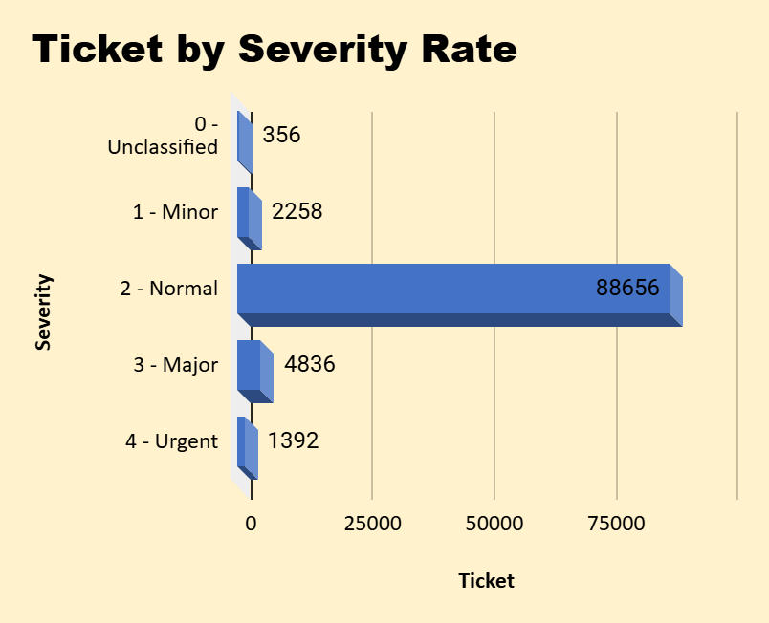
TICKETS BY SEVERITY RATE
INSIGHTS :
There is a clear upward trend in the volume of tickets year over year, with the number of tickets rising significantly from 2016 to 2020.
The sharp increase in 2020 suggests either a growth in users, an increase in system-related issues, or both, which may cause additional strain on support resources.

Slide 15
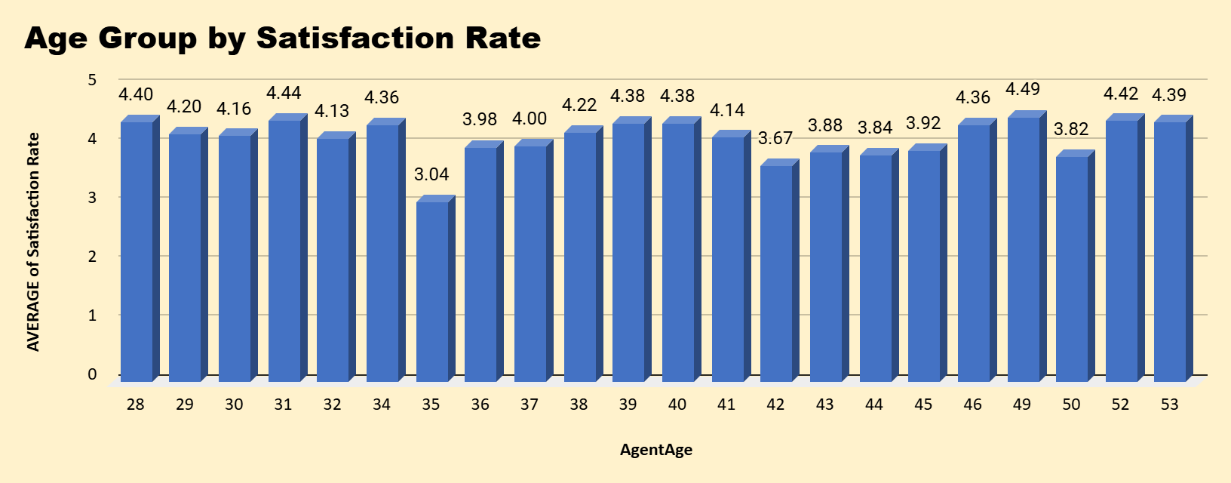
AGE GROUP BY SATISFACTION RATE
INSIGHTS :
Peak satisfaction is seen at ages 32, 49, and 50 (above 4.4), showing these age groups deliver the best service quality.
A major dip at age 35 (3.04) indicates performance issues; targeted training is needed.
Overall stability exists across most other age groups (4.0–4.3), with senior agents (49–53) again showing higher satisfaction due to experience.

Slide 16
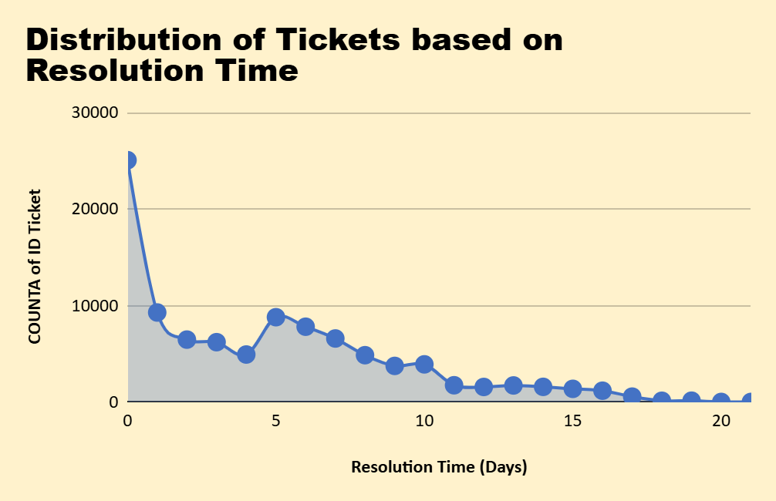
Distribution of Ticket by Resolution Time
INSIGHTS :
The majority of tickets are resolved within the first 1-2 days, indicating efficient handling of many issues.
There is a gradually decreasing number of tickets as resolution time increases, though a noticeable tail exists with some tickets taking over 10 days to resolve, suggesting occasional complexities or process delays.
This long-tail distribution implies that while most cases are routine and quickly addressed, a non-trivial subset of issues require extended follow-up or escalation.

Slide 17
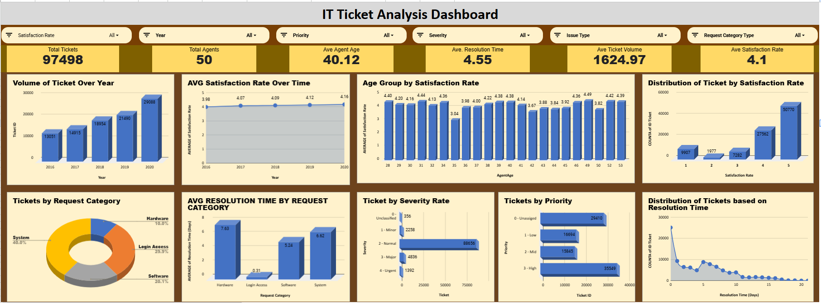
Dashboard

Slide 18
CONCLUSION
INSIGHTS
Ticket volume Trends :
Peak Times : High ticket volumes observed during specific periods such as system updates
Recurring Issues : Login issues and software related repeated issues can be provided with documented solutions
Resolution Time :
Delays in resolution : Average resolution time for critical tickets is above SLA thresholds
Bottlenecks identified : Specific agents causing delays (lack of skills or missing expertise)
Categorization and Prioritization :
Tickets are often miscategorized, leading to delays in routing and resolution
User Feedback :
Poor satisfaction ratings linked to delayed responses and lack of follow-up communication
Resource Allocation :
Understaffing during peak periods leading to backlog accumulation

Slide 19
RECOMMENDATIONS
Automation and Self-Service : Implement self-service portals and automated workflows for common issues
Process Improvements : Streamline ticket routing processes to minimize misclassification
Resource Optimization : Adjusting staffing levels based on historical volume trends, train junior agents to handle medium-complex tickets to reduce dependency on senior agents
Enhanced Monitoring and Analytics : Regularly review SLA performance and resolution time trends
Knowledge Base Development : Expand and regularly update guides, documents containing recurring issues to reduce ticket inflow

Slide 20


